Slide 1
Text Classification and Naive Bayes
The Task of Text Classification

Slide 2
Is this spam?

Slide 3
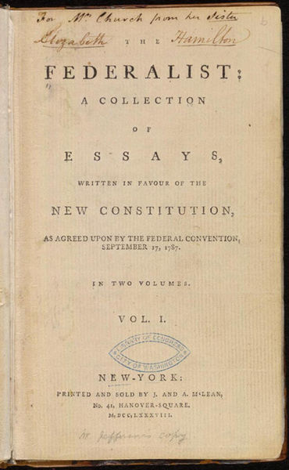
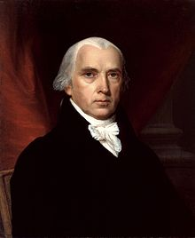
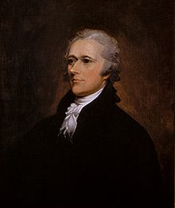
Who wrote which Federalist papers?
1787-8: anonymous essays try to convince New York to ratify U.S Constitution: Jay, Madison, Hamilton.
Authorship of 12 of the letters in dispute
1963: solved by Mosteller and Wallace using Bayesian methods
James Madison
Alexander Hamilton

Slide 4
What is the subject of this medical article?
MEDLINE Article
MeSH Subject Category Hierarchy
Antogonists and Inhibitors
Blood Supply
Chemistry
Drug Therapy
Embryology
Epidemiology
…
?

Slide 5
Positive or negative movie review?
+
...zany characters and richly applied satire, and some great plot twists
It was pathetic. The worst part about it was the boxing scenes...
...awesome caramel sauce and sweet toasty almonds. I love this place!
...awful pizza and ridiculously overpriced...
−
+
−

Slide 6
Why sentiment analysis?
Movie: is this review positive or negative?
Products: what do people think about the new iPhone?
Public sentiment: how is consumer confidence?
Politics: what do people think about this candidate or issue?
Prediction: predict election outcomes or market trends from sentiment

Slide 7
Positive or negative movie review?
+
...zany characters and richly applied satire, and some great plot twists
It was pathetic. The worst part about it was the boxing scenes...
...awesome caramel sauce and sweet toasty almonds. I love this place!
...awful pizza and ridiculously overpriced...
−
+
−

Slide 8
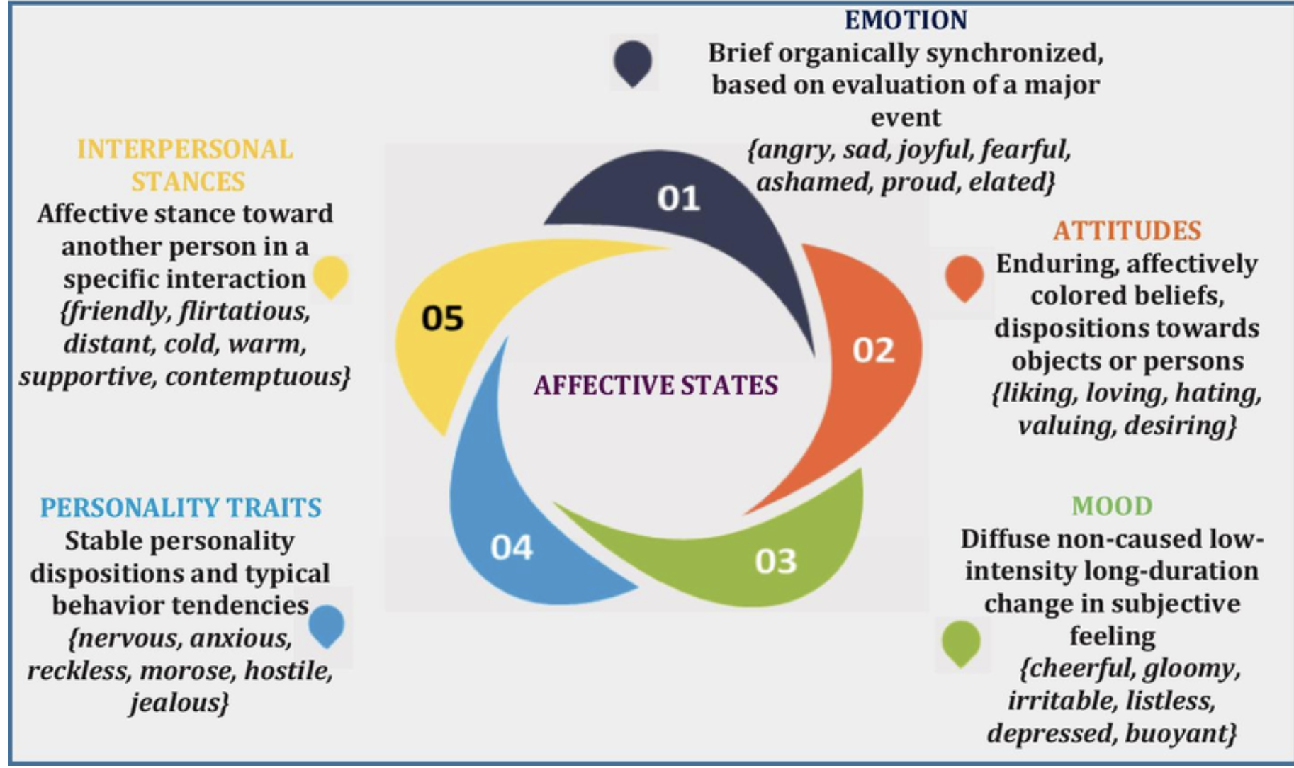
Affective States: Typology by K.R. Scherer (2009)
Credit for diagram to A. Kumar, https://doi.org/10.1007/s11042-021-11262-8

Slide 9
Scherer Typology of Affective States
Emotion: brief organically synchronized … evaluation of a major event
angry, sad, joyful, fearful, ashamed, proud, elated
Mood: diffuse non-caused low-intensity long-duration change in subjective feeling
cheerful, gloomy, irritable, listless, depressed, buoyant
Interpersonal stances: affective stance toward another person in a specific interaction
friendly, flirtatious, distant, cold, warm, supportive, contemptuous
Attitudes: enduring, affectively colored beliefs, dispositions towards objects or persons
liking, loving, hating, valuing, desiring
Personality traits: stable personality dispositions and typical behavior tendencies
nervous, anxious, reckless, morose, hostile, jealous

Slide 10
Scherer Typology of Affective States
Emotion: brief organically synchronized … evaluation of a major event
angry, sad, joyful, fearful, ashamed, proud, elated
Mood: diffuse non-caused low-intensity long-duration change in subjective feeling
cheerful, gloomy, irritable, listless, depressed, buoyant
Interpersonal stances: affective stance toward another person in a specific interaction
friendly, flirtatious, distant, cold, warm, supportive, contemptuous
Attitudes: enduring, affectively colored beliefs, dispositions towards objects or persons
liking, loving, hating, valuing, desiring
Personality traits: stable personality dispositions and typical behavior tendencies
nervous, anxious, reckless, morose, hostile, jealous

Slide 11
Basic Sentiment Classification
Sentiment analysis is the detection of attitudes
Simple task we focus on in this chapter
Is the attitude of this text positive or negative?
We return to affect classification in later chapters

Slide 12
Summary: Text Classification
Sentiment analysis
Spam detection
Authorship identification
Language Identification
Assigning subject categories, topics, or genres
…

Slide 13
Text Classification: definition
Input:
a document d
a fixed set of classes C = {c₁, c₂,…, c_{J}}
Output: a predicted class c ∈ C

Slide 14
Classification Methods: Hand-coded rules
Rules based on combinations of words or other features
spam: black-list-address OR (“dollars” AND “you have been selected”)
Accuracy can be high
If rules carefully refined by expert
But building and maintaining these rules is expensive

Slide 15
Classification Methods: Supervised Machine Learning
Input:
a document d
a fixed set of classes C = {c₁, c₂,…, c_{J}}
A training set of m hand-labeled documents (d₁,c₁),....,(d_{m},c_{m})
Output:
a learned classifier γ:d → c

Slide 16
Classification Methods: Supervised Machine Learning
Any kind of classifier
Naïve Bayes
Logistic regression
Neural networks
k-Nearest Neighbors
…

Slide 17
Text Classification and Naive Bayes
The Task of Text Classification

Slide 18
Text Classification and Naive Bayes
The Naive Bayes Classifier
Notes:
In this lecture we define the Naive Bayes classifier, a basic text classifier that will allow us to introduce many of the fundamental issues in text classification.

Slide 19
Naive Bayes Intuition
Simple ("naive") classification method based on Bayes rule
Relies on very simple representation of document
Bag of words

Slide 20
The Bag of Words Representation

Slide 21


The bag of words representation
seen | 2
sweet | 1
whimsical | 1
recommend | 1
happy | 1
... | ...
γ(
)=c

Slide 22
Bayes’ Rule Applied to Documents and Classes
For a document d and a class c

Slide 23
Naive Bayes Classifier (I)
MAP is “maximum a posteriori” = most likely class
Bayes Rule
Dropping the denominator

Slide 24
Naive Bayes Classifier (II)
"Likelihood"
"Prior"
Document d represented as features x1..xn

Slide 25
Naïve Bayes Classifier (IV)
O(|X|^{n}•|C|) parameters
How often does this class occur?
Could only be estimated if a very, very large number of training examples was available.
We can just count the relative frequencies in a corpus

Slide 26
Multinomial Naive Bayes Independence Assumptions
Bag of Words assumption: Assume position doesn’t matter
Conditional Independence: Assume the feature probabilities P(x_{i}|c_{j}) are independent given the class c.

Slide 27
Multinomial Naive Bayes Classifier

Slide 28
Applying Multinomial Naive Bayes Classifiers to Text Classification
positions ← all word positions in test document

Slide 29
Problems with multiplying lots of probs
There's a problem with this:
Multiplying lots of probabilities can result in floating-point underflow!
.0006 * .0007 * .0009 * .01 * .5 * .000008….
Idea: Use logs, because log(ab) = log(a) + log(b)
We'll sum logs of probabilities instead of multiplying probabilities!

Slide 30
We actually do everything in log space
Instead of this:
This:
Notes:
1) Taking log doesn't change the ranking of classes!
The class with highest probability also has highest log probability!
2) It's a linear model:
Just a max of a sum of weights: a linear function of the inputs
So naive bayes is a linear classifier

Slide 31
Text Classification and Naive Bayes
The Naive Bayes Classifier
Notes:
We've now seen the basic principles of naïve bayes classification!

Slide 32
Text Classification and Naïve Bayes
Naive Bayes: Learning

Slide 33
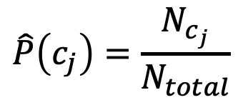
Learning the Multinomial Naive Bayes Model
Sec.13.3
First attempt: maximum likelihood estimates
simply use the frequencies in the data
$$\hat{P}\left(c_{j}\right)=\frac{N_{c_{j}}}{N_{total}}$$

Slide 34
Parameter estimation
fraction of times word w_{i} appears
among all words in documents of topic c_{j}
Create mega-document for topic j by concatenating all docs in this topic
Use frequency of w in mega-document

Slide 35
Problem with Maximum Likelihood
Sec.13.3
What if we have seen no training documents with the word fantastic and classified in the topic positive (thumbs-up)?
Zero probabilities cannot be conditioned away, no matter the other evidence!

Slide 36
Laplace (add-1) smoothing for Naïve Bayes

Slide 37
Multinomial Naïve Bayes: Learning
From training corpus, extract Vocabulary
Calculate P(c_{j}) terms
For each c_{j} in C do
docs_{j} ← all docs with class =c_{j}
Calculate P(w_{k} | c_{j}) terms
Text_{j} ← single doc containing all docs_{j}
For each word w_{k} in Vocabulary
n_{k} ← # of occurrences of w_{k} in Text_{j}

Slide 38
Unknown words
What about unknown words
that appear in our test data
but not in our training data or vocabulary?
We ignore them
Remove them from the test document!
Pretend they weren't there!
Don't include any probability for them at all!
Why don't we build an unknown word model?
It doesn't help: knowing which class has more unknown words is not generally helpful!

Slide 39
Stop words
Some systems ignore stop words
Stop words: very frequent words like the and a.
Sort the vocabulary by word frequency in training set
Call the top 10 or 50 words the stopword list.
Remove all stop words from both training and test sets
As if they were never there!
But removing stop words doesn't usually help
So in practice most NB algorithms use all words and don't use stopword lists

Slide 40
Text Classification and Naive Bayes
Naive Bayes: Learning

Slide 41
Text Classification and Naive Bayes
Sentiment and Binary Naive Bayes
Notes:
In this lecture we'll do a worked example of naïve bayes sentiment analysis, and also introduce the binary multinominal naïve bayes algorithm.

Slide 42
Let's do a worked sentiment example!

Slide 43
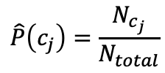
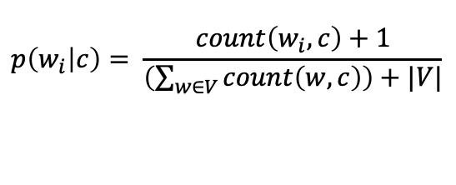
A worked sentiment example with add-1 smoothing
1. Prior from training:
$$\hat{P}\left(c_{j}\right)=\frac{N_{c_{j}}}{N_{total}}$$
P(-) = 3/5
P(+) = 2/5
2. Drop "with"
3. Likelihoods from training:
$$p\left(w_{i} | c\right)= \frac{count\left(w_{i},c\right)+1}{\left(\sum_{w∈V}{count\left(w,c\right)}\right)+|V|}$$
4. Scoring the test set:

Slide 44
Optimizing for sentiment analysis
For tasks like sentiment, word occurrence seems to be more important than word frequency.
The occurrence of the word fantastic tells us a lot
The fact that it occurs 5 times may not tell us much more.
Binary multinominal naive bayes, or binary NB
Clip our word counts at 1
Note: this is different than Bernoulli naive bayes; see the textbook at the end of the chapter.

Slide 45
Binary Multinomial Naïve Bayes: Learning
From training corpus, extract Vocabulary
Calculate P(c_{j}) terms
For each c_{j} in C do
docs_{j} ← all docs with class =c_{j}
Calculate P(w_{k} | c_{j}) terms
Text_{j} ← single doc containing all docs_{j}
For each word w_{k} in Vocabulary
n_{k} ← # of occurrences of w_{k} in Text_{j}
Remove duplicates in each doc:
For each word type w in doc_{j}
Retain only a single instance of w

Slide 46
Binary Multinomial Naive Bayes on a test document d
First remove all duplicate words from d
Then compute NB using the same equation:

Slide 47
Binary multinominal naive Bayes

Slide 48
Binary multinominal naive Bayes

Slide 49
Binary multinominal naive Bayes

Slide 50
Binary multinominal naive Bayes
Counts can still be 2! Binarization is within-doc!

Slide 51
Text Classification and Naive Bayes
Sentiment and Binary Naive Bayes

Slide 52
Text Classification and Naive Bayes
More on Sentiment Classification

Slide 53
Sentiment Classification: Dealing with Negation
I really like this movie
I really don't like this movie
Negation changes the meaning of "like" to negative.
Negation can also change negative to positive-ish
Don't dismiss this film
Doesn't let us get bored

Slide 54
Sentiment Classification: Dealing with Negation
Das, Sanjiv and Mike Chen. 2001. Yahoo! for Amazon: Extracting market sentiment from stock message boards. In Proceedings of the Asia Pacific Finance Association Annual Conference (APFA).
Bo Pang, Lillian Lee, and Shivakumar Vaithyanathan. 2002. Thumbs up? Sentiment Classification using Machine Learning Techniques. EMNLP-2002, 79—86.
Simple baseline method:
Add NOT_ to every word between negation and following punctuation:
didn’t like this movie , but I
didn’t NOT_like NOT_this NOT_movie but I

Slide 55
Contextual Valence Shifters
Term coined by Livia Polanyi and Annie Zaenen
Reference: L. Polanyi and A. Zaenen (2004). Contextual Valence Shifters. AAAI Symposium on Attitude.
The following slides are based on contents from this paper.
Take-home message: there is much more to consider beyond negation for sentiment classification.
Notes:
The term shifter dates back all the way to Otto Jespersen and Roman Jacobson. But the term valence shifter originates as far as I know with Annie Zaenen and Livia Polanyi, a former colleague of mine. They published a very useful paper under this header. I want to present some of their observations because it shows that sentiment analysis involves much more than simple counting features that we have considered in Chapter 4 of the textbook.
Their main point is that there is much more to consider, in particular valence shifting of positive markers into negative markers

Slide 56
Simple Lexical Valence
PART OF SPEECH | Positive Valence | Negative Valence
Verbs | boost, embrace, ensure, encourage, delight, manage, ease | conspire, meddle, dis-courage, fiddle, fail, haggle
Nouns | approval, benefit, chance, credit, favor, freedom, hope | Backlash, backlog, bankcruptcy, beating, catastrophe
Adjectives | attractive, better, brave, bright | annoying, awry, arbitrary, bad, botched
Adverbs | Attractively, ... | annoyingly, ...
Notes:
As a starting point they distinguish between positive and negative valence. They point out that this distinction manifests itself in all open-class parts of speech; verbs, nouns, adjective, and adverbs

Slide 57
Lexical Valence in Text
Text 1: The eighteen year-old walked through the part of town where he lived. He stopped for a while to talk with people on the street and then went to a store for some food to bring to the small apartment where he lived with some people he knew.
Text 2: The young man⁺ strolled⁺ through his neighborhood⁺. He lingered⁺ to chat⁺ with people onthe street and then dropped into⁺ a shop⁺ for some goodies⁺ to bring home⁺ to the cozy⁺ place which he shared⁺ with some friends⁺.
Text 3. The teenaged male⁻ strutted⁻ through his turf. He loitered⁻ to shoot the bull⁻ with people on the street and then ducked⁻ into a dive⁻ for some grub⁻ to bring to the cramped hole-in-the-wall⁻ where he crashed⁻ with some cronies⁻.
Notes:
To illustrate how lexical valence influences interpretation, let us look briefly at three short texts. While all of the texts communicate the same denotative information, the connotative force of each version is different. In the first text, the protagonist is an unremarkable young man, in the second text, he is a much friendlier, warmer sort of chap while he emerges in the third text as a juvenile delinquent. The effect is created by substitution of large neutral terms by near synonyms that conventionally express positive or negative sentiment or attitude.

Slide 58
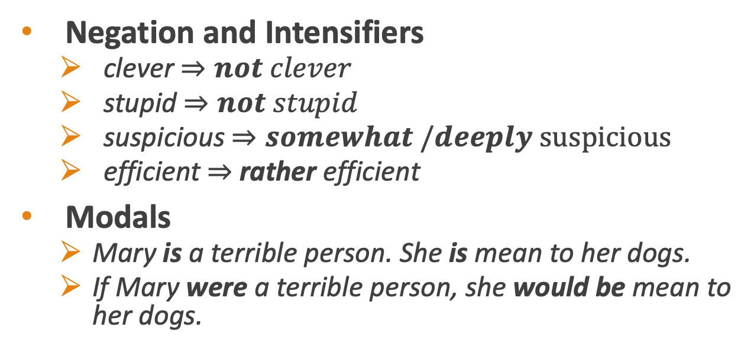
Contextual Valence Shifters
Negation and Intensifiers
clever $⇒not clever$
stupid $⇒not stupid$
suspicious $⇒somewhat /deeply suspicious$
efficient $⇒$ rather efficient
Modals
Mary is a terrible person. She is mean to her dogs.
If Mary were a terrible person, she would be mean to her dogs.
Notes:
Let us take a look beyond lexical valence and look at contextual valence shifters.

Slide 59
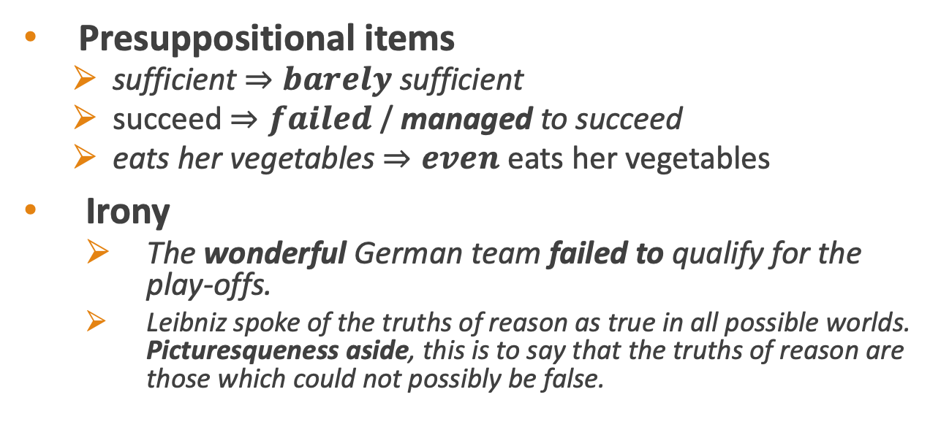
Contextual Valence Shifters
Presuppositional items
sufficient $⇒barely$ sufficient
succeed $⇒failed$ / managed to succeed
eats her vegetables $⇒even$ eats her vegetables
Irony
The wonderful German team failed to qualify for the play-offs.
Leibniz spoke of the truths of reason as true in all possible worlds. Picturesqueness aside, this is to say that the truths of reason are those which could not possibly be false.
Notes:
Irony: juxtaposition of an strong positive adjective with a negative verbal predicate. Second example is a quote from a famous philosophical paper by Willard Van Orman Quine entitled Two Dogmas of Empiricism. Does this convey a positive or a negative attitude to Leibniz‘s view summarized in the first sentence. The answer is yes and no.

Slide 60
Discourse Based Contextual Valence Shifters
Although Boris is brilliant at math, he is a horrible teacher.
The utility company argues that they performed well, but the public still remembers those miserable rotten nights.
The economic situation is more than satisfactory. When one looks at the human rights picture, one is struck by the increase in arbitrary arrests and by needless persecution of helpless citizens, and increase in police brutality.
Notes:
Indirect speech – something that Jacobson already identified as a shifter in an article in a well-known 1957 article entitle Shifters, verbal categories, and the Russian verb

Slide 61
Sentiment Classification: Lexicons
Sometimes we don't have enough labeled training data
In that case, we can make use of pre-built word lists
called lexicons
There are various publicly available lexicons

Slide 62
MPQA Subjectivity Cues Lexicon
Theresa Wilson, Janyce Wiebe, and Paul Hoffmann (2005). Recognizing Contextual Polarity in
Phrase-Level Sentiment Analysis. Proc. of HLT-EMNLP-2005.
Riloff and Wiebe (2003). Learning extraction patterns for subjective expressions. EMNLP-2003.
Home page: https://mpqa.cs.pitt.edu/lexicons/subj_lexicon/
6885 words from 8221 lemmas, annotated for intensity (strong/weak)
2718 positive
4912 negative
+ : admirable, beautiful, confident, dazzling, ecstatic, favor, glee, great
− : awful, bad, bias, catastrophe, cheat, deny, envious, foul, harsh, hate

Slide 63
The General Inquirer
Philip J. Stone, Dexter C Dunphy, Marshall S. Smith, Daniel M. Ogilvie. 1966. The General Inquirer: A Computer Approach to Content Analysis. MIT Press
Home page: http://www.wjh.harvard.edu/~inquirer
List of Categories: http://www.wjh.harvard.edu/~inquirer/homecat.htm
Spreadsheet: http://www.wjh.harvard.edu/~inquirer/inquirerbasic.xls
Categories:
Positiv (1915 words) and Negativ (2291 words)
Strong vs Weak, Active vs Passive, Overstated versus Understated
Pleasure, Pain, Virtue, Vice, Motivation, Cognitive Orientation, etc
Free for Research Use

Slide 64
Using Lexicons in Sentiment Classification
Add a feature that gets a count whenever a word from the lexicon occurs
E.g., a feature called "this word occurs in the positive lexicon" or "this word occurs in the negative lexicon"
Now all positive words (good, great, beautiful, wonderful) or negative words count for that feature.
Using 1-2 features isn't as good as using all the words.
But when training data is sparse or not representative of the test set, dense lexicon features can help

Slide 65
Naive Bayes in Other tasks: Spam Filtering
SpamAssassin Features:
Mentions millions of (dollar) ((dollar) NN,NNN,NNN.NN)
From: starts with many numbers
Subject is all capitals
HTML has a low ratio of text to image area
"One hundred percent guaranteed"
Claims you can be removed from the list

Slide 66
Naive Bayes in Language ID
Determining what language a piece of text is written in.
Features based on character n-grams do very well
Important to train on lots of varieties of each language
(e.g., American English varieties like African-American English, or English varieties around the world like Indian English)

Slide 67
Summary: Naive Bayes is Not So Naive
Very Fast, low storage requirements
Work well with very small amounts of training data
Robust to Irrelevant Features
Irrelevant Features cancel each other without affecting results
Very good in domains with many equally important features
Decision Trees suffer from fragmentation in such cases – especially if little data
Optimal if the independence assumptions hold: If assumed independence is correct, then it is the Bayes Optimal Classifier for problem
A good dependable baseline for text classification
But we will see other classifiers that give better accuracy
Slide from Chris Manning

Slide 68
Text Classification and Naive Bayes
More on Sentiment Classification

Slide 69
Text Classification and Naïve Bayes
Naïve Bayes: Relationship to Language Modeling

Slide 70
Generative Model for Multinomial Naïve Bayes
c=+
X₁=I
X₂=love
X₃=this
X₄=fun
X₅=film

Slide 71
Naïve Bayes and Language Modeling
Naïve bayes classifiers can use any sort of feature
URL, email address, dictionaries, network features
But if, as in the previous slides
We use only word features
we use all of the words in the text (not a subset)
Then
Naive bayes has an important similarity to language modeling.

Slide 72
Each class = a unigram language model
Sec.13.2.1
Assigning each word: P(word | c)
Assigning each sentence: P(s|c)=Π P(word|c)
Class pos
0.1 I
0.1 love
0.01 this
0.05 fun
0.1 film
…
I
love
this
fun
film
0.1
0.1
.05
0.01
0.1
P(s | pos) = 0.0000005

Slide 73
Naïve Bayes as a Language Model
Sec.13.2.1
Which class assigns the higher probability to s?
Model pos
Model neg
0.2 I
0.001 love
0.01 this
0.005 fun
0.1 film
0.1 I
0.1 love
0.01 this
0.05 fun
0.1 film
I
love
this
fun
film
0.1
0.1
0.01
0.05
0.1
0.2
0.001
0.01
0.005
0.1
P(s|pos) > P(s|neg)

Slide 74
Text Classification and Naïve Bayes
Naïve Bayes: Relationship to Language Modeling

Slide 75
Text Classification and Naïve Bayes
Precision, Recall, and F measure

Slide 76
Evaluation
Let's consider just binary text classification tasks
Imagine you're the CEO of Delicious Pie Company
You want to know what people are saying about your pies
So you build a "Delicious Pie" tweet detector
Positive class: tweets about Delicious Pie Co
Negative class: all other tweets

Slide 77
The 2-by-2 confusion matrix

Slide 78
Evaluation: Accuracy
Why don't we use accuracy as our metric?
Imagine we saw 1 million tweets
100 of them talked about Delicious Pie Co.
999,900 talked about something else
We could build a dumb classifier that just labels every tweet "not about pie"
It would get 99.99% accuracy!!! Wow!!!!
But useless! Doesn't return the comments we are looking for!
That's why we use precision and recall instead

Slide 79
Evaluation: Precision
% of items the system detected (i.e., items the system labeled as positive) that are in fact positive (according to the human gold labels)

Slide 80
Evaluation: Recall
% of items actually present in the input that were correctly identified by the system.

Slide 81
Why Precision and recall
Our dumb pie-classifier
Just label nothing as "about pie"
Accuracy=99.99%
but
Recall = 0
(it doesn't get any of the 100 Pie tweets)
Precision and recall, unlike accuracy, emphasize true positives:
finding the things that we are supposed to be looking for.

Slide 82
A combined measure: F
F measure: a single number that combines P and R:
We almost always use balanced F₁ (i.e., β = 1)

Slide 83
Development Test Sets ("Devsets") and Cross-validation
Train on training set, tune on devset, report on testset
This avoids overfitting (‘tuning to the test set’)
More conservative estimate of performance
But paradox: want as much data as possible for training, and as much for dev; how to split?
Training set
Development Test Set
Test Set

Slide 84
Cross-validation: multiple splits
Pool results over splits, Compute pooled dev performance

Slide 85
Text Classification and Naive Bayes
Precision, Recall, and F measure

Slide 86
Text Classification and Naive Bayes
Evaluation with more than two classes

Slide 87
Confusion Matrix for 3-class classification

Slide 88
How to combine P/R from 3 classes to get one metric
Macroaveraging:
compute the performance for each class, and then average over classes
Microaveraging:
collect decisions for all classes into one confusion matrix
compute precision and recall from that table.

Slide 89
Macroaveraging and Microaveraging

Slide 90
Multi-Class (multi-value) Classification
A special case of multinomial classification is multi-class classification, where a document can be assigned to more than one class.
Two questions need to be addressed for this case:
How can such multi-class classification models be implemented?
How can such multi-class classification models be evaluated?

Slide 91
Data Resource: Reuters-21578 Data Set
21,578 docs (each 90 word types, 200 tokens)
118 distinct categories
An article can be in more than one category
Average document(with at least one category) has at 1.24 classes
Only about 10 of 118 categories are large
(#train,#test):earn(2877,1087),acquisitions (1650,179), money-fx(538,179),grain(433,149),crude(389,189),trade(369,119), interest(347,131),ship(197,89),wheat(212,71),corn (182,56)

Slide 92
Reuters-21578 Data Sample Excerpt
<DATE> 2-MAR-1987 16:51:43:42</DATE>
<TOPICS><D>livestock</D> ><D>hog</D> </TOPICS>
<DATELINE> Chicago, March 2 - </DATELINE> <BODY> The American Pork Congress kicks off tomorrow, March 3, in Indianapolis with 160 of the nations pork producers from 44 member states determining industry positions on a number of issues, according to the National Pork Producers Council, NPPC. … <BODY>

Slide 93
How to implement a multi-value classifier?
Two alternatives:
Learn one classifier with a potentially very large number of possible class assignments
For example: for 118 categories, the worst case number of possible categories is 2¹¹⁸
Learn n-many binary classifiers: one for each category
For example: for 118 categories, 118 binary classifiers

Slide 94
How to evaluate multi-value classifiers
Use precision recall, precision, and F-score
Accuracy is not a good measure particularly of the number of training samples are not balanced.

Slide 95
Confusion matrix c_{ij}
For each pair of classes <c_{i},c_{j}> how many documents from c_{i} were incorrectly assigned to c_{j}? E.g.: c_{3,2:} 90 wheat documents incorrectly assigned to poultry.
Docs in test set | Assigned UK | Assigned poultry | Assigned wheat | Assigned coffee | Assigned interest | Assigned trade
True UK | 95 | 1 | 13 | 0 | 1 | 0
True poultry | 0 | 1 | 0 | 0 | 0 | 0
True wheat | 10 | 90 | 0 | 1 | 0 | 0
True coffee | 0 | 0 | 0 | 34 | 3 | 7
True interest | 0 | 1 | 2 | 13 | 26 | 5
True trade | 0 | 0 | 2 | 14 | 5 | 10

Slide 96
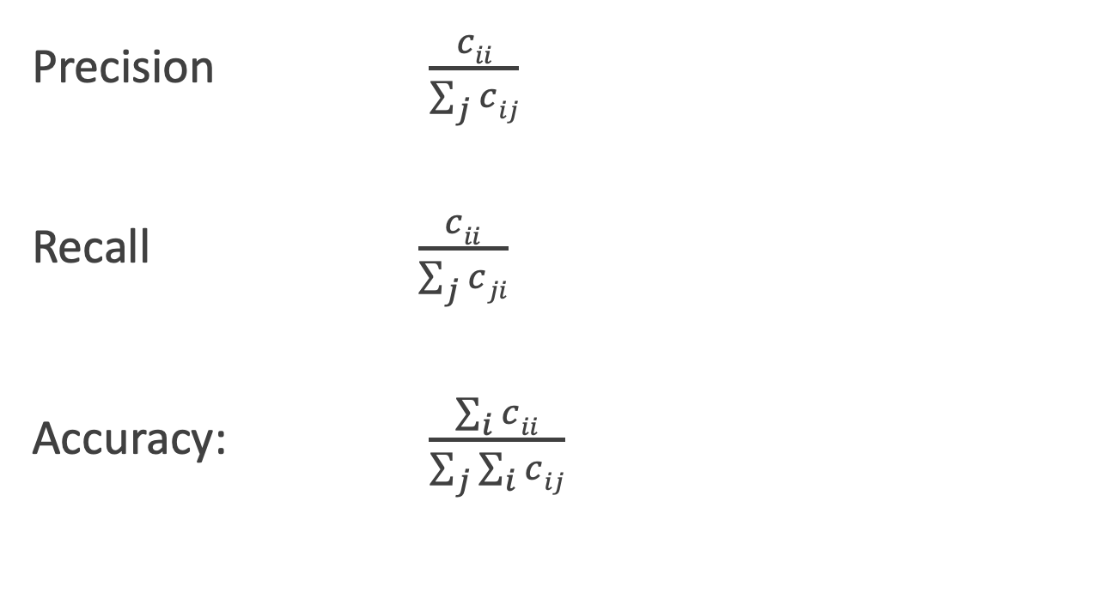
Per Class Evaluation Measures
Precision $\frac{cii}{\sum_{j}{c}ij}$
Recall $\frac{cii}{\sum_{j}{c}ji}$
Accuracy: $\frac{\sum_{i}{c}ii}{\sum_{j}{\sum_{i}{c}}ij}$

Slide 97
Text Classification and Naive Bayes
Evaluation with more than two classes

Slide 98
Text Classification and Naive Bayes
Statistical Significance Testing

Slide 99
How do we know if one classifier is better than another?
Given:
Classifier A and B
Metric M: M(A,x) is the performance of A on testset x
𝛿(x): the performance difference between A, B on x:
𝛿(x) = M(A,x) – M(B,x)
We want to know if 𝛿(x)>0, meaning A is better than B
𝛿(x) is called the effect size
Suppose we look and see that 𝛿(x) is positive. Are we done?
No! This might be just an accident of this one test set, or circumstance of the experiment. Instead:

Slide 100
Statistical Hypothesis Testing
Consider two hypotheses:
Null hypothesis: A isn't better than B
A is better than B
We want to rule out H₀
We create a random variable X ranging over test sets
And ask, how likely, if H₀ is true, is it that among these test sets we would see the 𝛿(x) we did see?
Formalized as the p-value:

Slide 101
Statistical Hypothesis Testing
In our example, this p-value is the probability that we would see δ(x) assuming H₀ (=A is not better than B).
If H₀ is true but δ(x) is huge, that is surprising! Very low probability!
A very small p-value means that the difference we observed is very unlikely under the null hypothesis, and we can reject the null hypothesis
Very small: .05 or .01
A result(e.g., “A is better than B”) is statistically significant if the δ we saw has a probability that is below the threshold and we therefore reject this null hypothesis.

Slide 102
Statistical Hypothesis Testing
How do we compute this probability?
In NLP, we don't tend to use parametric tests (like t-tests)
Instead, we use non-parametric tests based on sampling: artificially creating many versions of the setup.
For example, suppose we had created zillions of testsets x'.
Now we measure the value of 𝛿(x') on each test set
That gives us a distribution
Now set a threshold (say .01).
So if we see that in 99% of the test sets 𝛿(x) > 𝛿(x')
We conclude that our original test set delta was a real delta and not an artifact.

Slide 103
Statistical Hypothesis Testing
Two common approaches:
approximate randomization
bootstrap test
Paired tests:
Comparing two sets of observations in which each observation in one set can be paired with an observation in another.
For example, when looking at systems A and B on the same test set, we can compare the performance of system A and B on each same observation x_{i}

Slide 104
Text Classification and Naive Bayes
Statistical Significance Testing

Slide 105
Text Classification and Naive Bayes
The Paired Bootstrap Test

Slide 106
Bootstrap test
Efron and Tibshirani, 1993
Can apply to any metric (accuracy, precision, recall, F1, etc).
Bootstrap means to repeatedly draw large numbers of smaller samples with replacement (called bootstrap samples) from an original larger sample.

Slide 107
Bootstrap example
Consider a baby text classification example with a test set x of 10 documents, using accuracy as metric.
Suppose these are the results of systems A and B on x, with 4 outcomes (A & B both right, A & B both wrong, A right/B wrong, A wrong/B right):
either A+B both correct, or

Slide 108
Bootstrap example
Now we create, many, say, b=10,000 virtual test sets x(i), each of size n = 10.
To make each x(i), we randomly select a cell from row x, with replacement, 10 times:

Slide 109
Bootstrap example
Now we have a distribution! We can check how often A has an accidental advantage, to see if the original 𝛿(x) we saw was very common.
Now assuming H₀, that means normally we expect 𝛿(x')=0
So we just count how many times the 𝛿(x') we found exceeds the expected 0 value by 𝛿(x) or more:

Slide 110
Bootstrap example
Alas, it's slightly more complicated.
We didn’t draw these samples from a distribution with 0 mean; we created them from the original test set x, which happens to be biased (by .20) in favor of A.
So to measure how surprising is our observed δ(x), we actually compute the p-value by counting how often δ(x') exceeds the expected value of δ(x) by δ(x) or more:

Slide 111
Bootstrap example
Suppose:
We have 10,000 test sets x(i) and a threshold of .01
And in only 47 of the test sets do we find that δ(x(i)) ≥ 2δ(x)
The resulting p-value is .0047
This is smaller than .01, indicating δ (x) is indeed sufficiently surprising
And we reject the null hypothesis and conclude A is better than B.

Slide 112
Paired bootstrap example
After Berg-Kirkpatrick et al (2012)

Slide 113
Text Classification and Naive Bayes
The Paired Bootstrap Test

Slide 114
Text Classification and Naive Bayes
Avoiding Harms in Classification

Slide 115
Harms in sentiment classifiers
Kiritchenko and Mohammad (2018) found that most sentiment classifiers assign lower sentiment and more negative emotion to sentences with African American names in them.
This perpetuates negative stereotypes that associate African Americans with negative emotions

Slide 116
Harms in toxicity classification
Toxicity detection is the task of detecting hate speech, abuse, harassment, or other kinds of toxic language
But some toxicity classifiers incorrectly flag as being toxic sentences that are non-toxic but simply mention identities like blind people, women, or gay people.
This could lead to censorship of discussion about these groups.

Slide 117
What causes these harms?
Can be caused by:
Problems in the training data; machine learning systems are known to amplify the biases in their training data.
Problems in the human labels
Problems in the resources used (like lexicons)
Problems in model architecture (like what the model is trained to optimized)
Mitigation of these harms is an open research area
Meanwhile: model cards

Slide 118
Model Cards
(Mitchell et al., 2019)
For each algorithm you release, document:
training algorithms and parameters
training data sources, motivation, and preprocessing
evaluation data sources, motivation, and preprocessing
intended use and users
model performance across different demographic or other groups and environmental situations

Slide 119
Text Classification and Naive Bayes
Avoiding Harms in Classification

